Slide 1

Situating the Atlas

Slide 2

Dimensions
Time, space, knowledge, flows
Accumulation, interscalar, sensing
What? And Who?

Slide 3
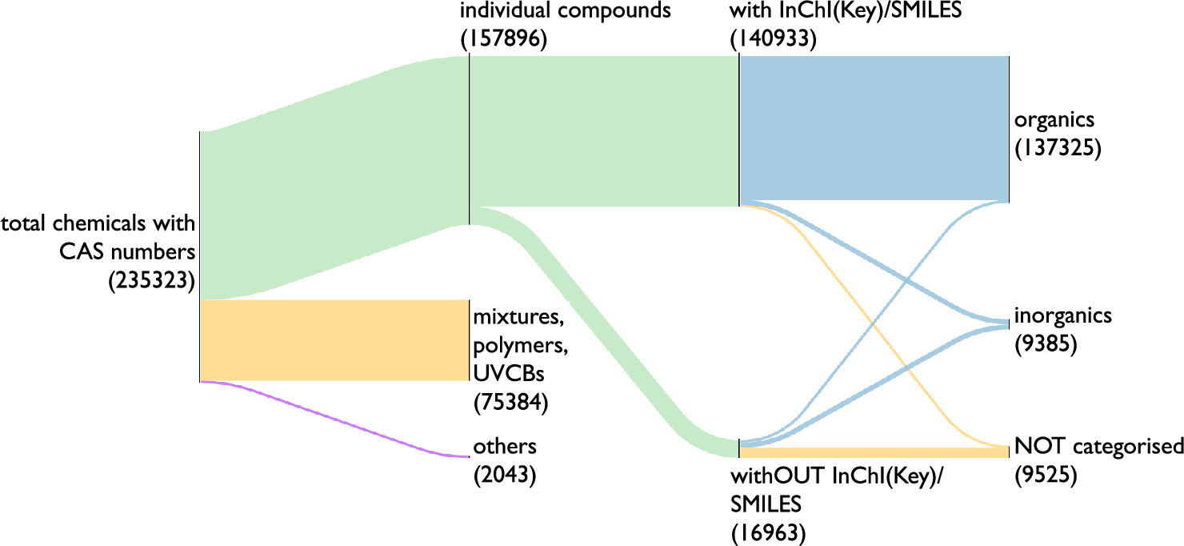
Chemical Universe(s)
Toward a Global Understanding of Chemical Pollution: A First Comprehensive Analysis of National and Regional Chemical Inventories
Zhanyun Wang, Glen W. Walker, Derek C. G. Muir, and Kakuko Nagatani-Yoshida
Environmental Science & Technology 2020 54 (5), 2575-2584, DOI: 10.1021/acs.est.9b06379

Slide 4
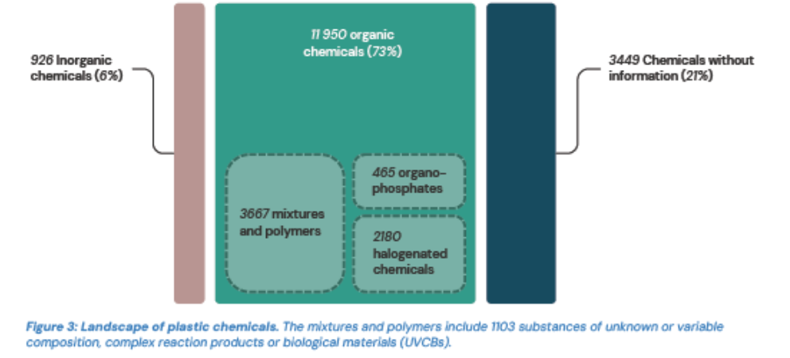
Chemical Universe(s)
Plastic Chemicals: https://plastchem-project.org/

Slide 5
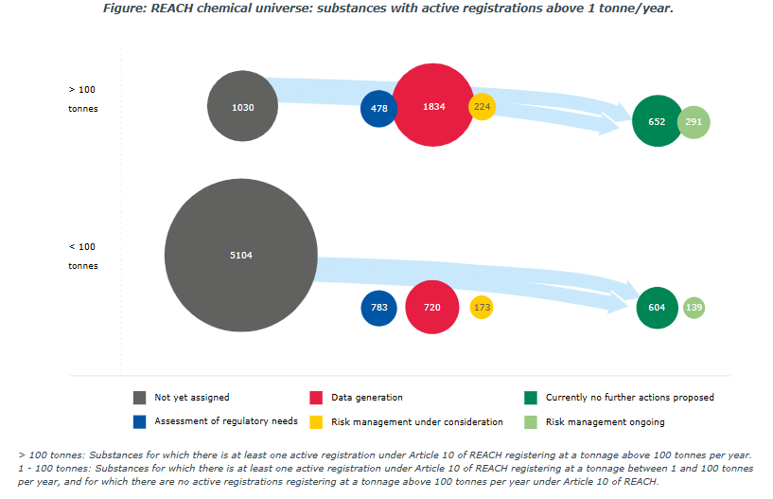
Chemical Universe(s)
ECHA’s Universe of Registered Substances https://echa.europa.eu/universe-of-registered-substances

Slide 6
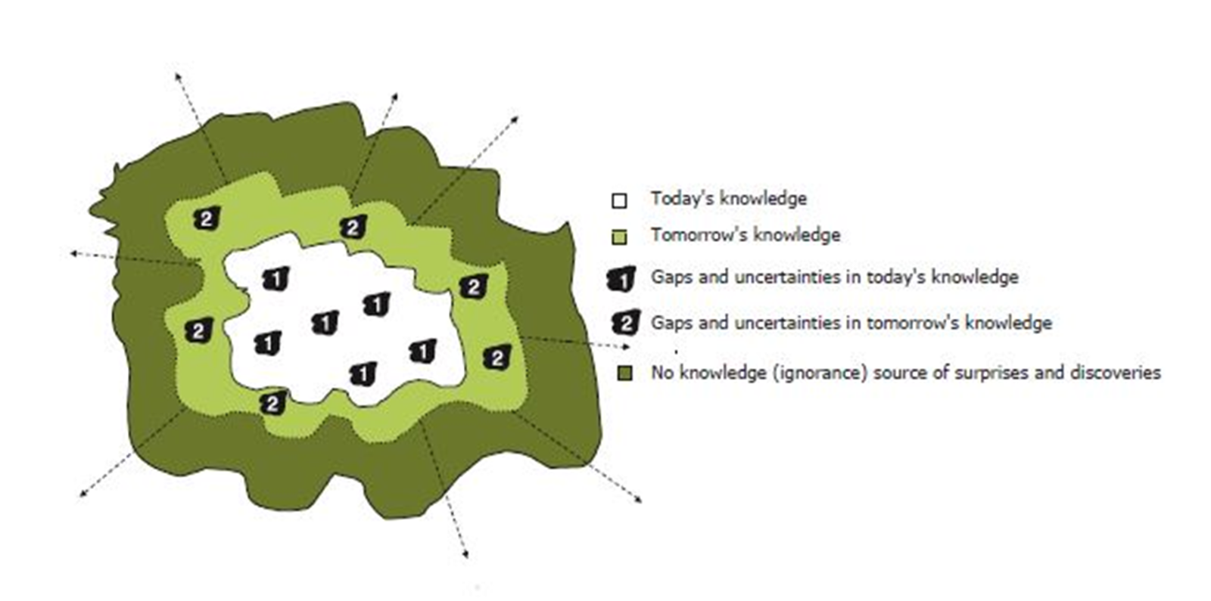
Knowledge(s) (and Time)
EEA’s Late Lessons from Early Warnings
https://www.eea.europa.eu/en/analysis/publications/late-lessons-2

Slide 7
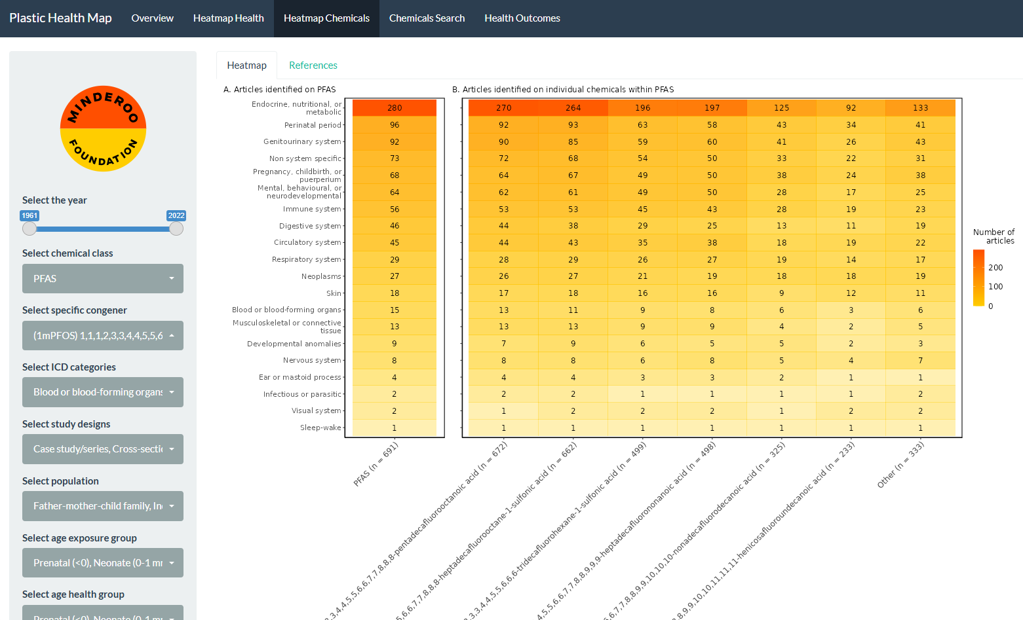
Knowledge(s) – Chemicals and Effects

Slide 8
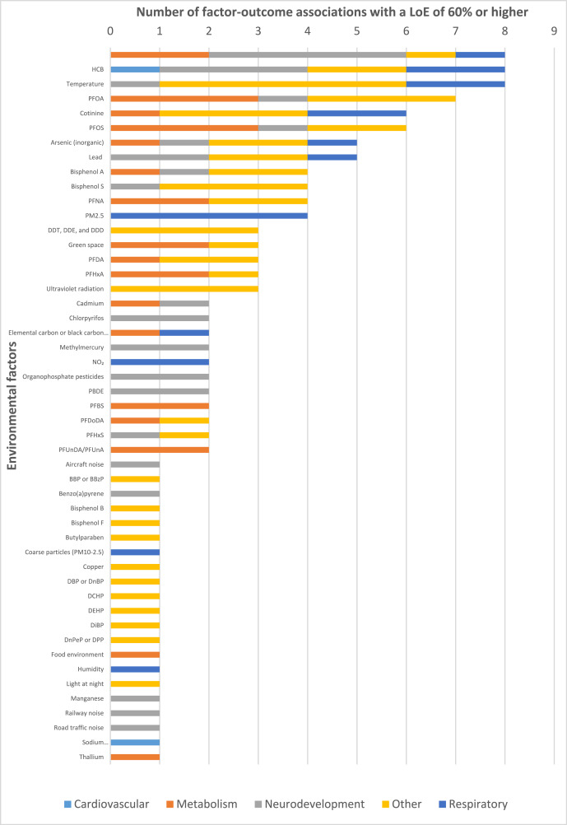
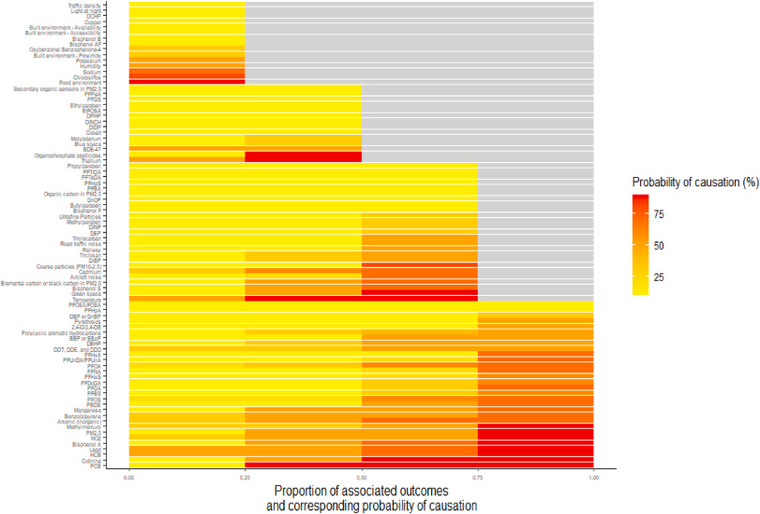
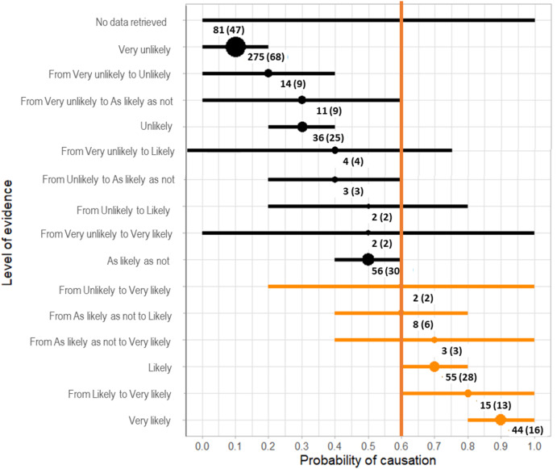
Knowledge(s) – Chemicals, Effects, and Uncertainty
Colzin et al (2024) A plausibility database summarizing the level of evidence regarding the hazards induced by the exposome on children health, International Journal of Hygiene and Environmental Health, 256: 114311,
https://doi.org/10.1016/j.ijheh.2023.114311
Fig. 4. Distribution of the highest level of evidence by family of health outcome across exposure factors. For simplicity, the graph was limited to effects in the four main axes of cardiovascular, metabolic, neurologic and respiratory health. Substances were sorted by increasing level of evidence. In each of the four health outcome domains, the color indicates the outcome with the highest level of evidence with the considered exposure factor. Grey indicates a lack of data. Exposure factors were ranked by increasing overall LoE across all four health outcomes domains (cardiovascular, metabolism, neurodevelopment, respiratory health).
Fig. 2. Distribution of the number of factor-outcome pairs according to the overall LoE and the corresponding uncertainty (indicated by the horizontal line). Numbers indicate the number of factor-outcome pairs (the corresponding number of environmental factors is given in the parentheses). Factor-outcome pairs with a probability of causation above 60% are shown in orange.
Fig. 3. Number and family of health outcomes among the 127 factor-outcome pairs (corresponding to 49 factors) with an overall LoE of 60 % or more (central estimate of the reliability interval).

Slide 9
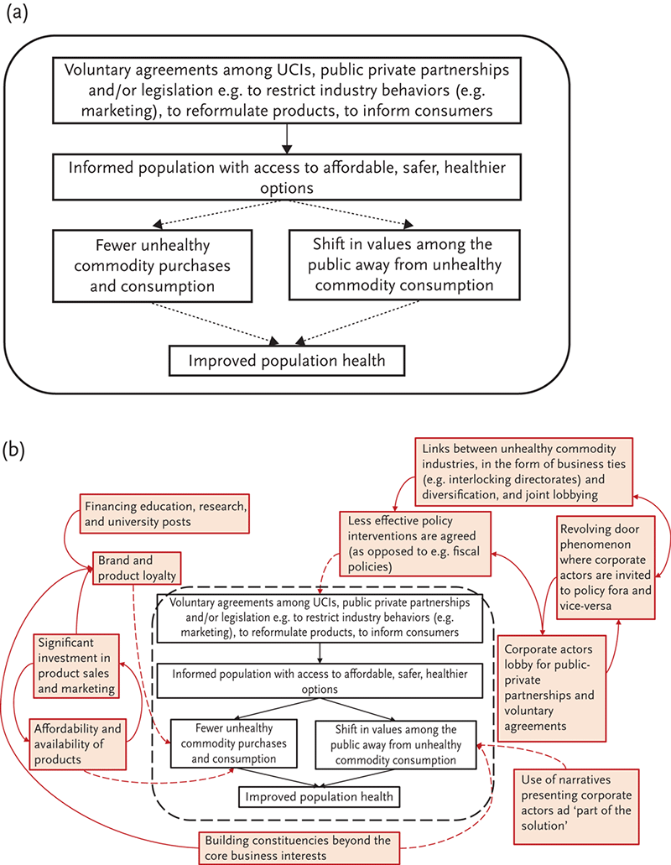
Stakeholders and Influence
The Commercial Determinants of Health, https://doi.org/10.1093/oso/9780197578742.003.0002
Figure 2.1 C2.F1 Demonstrating differences between linear (a) and systems (b) thinking in approaching commercial determinants of health through the example of voluntary agreements between unhealthy commodity industries (UCIs) and governments.

Slide 10
Stakeholders and Flows (and Influence, and Interscalar)
Gerassimidou et al (2022) Unpacking the complexity of the UK plastic packaging value chain: A stakeholder perspective, Sustainable Production and Consumption 30: 657-673, https://doi.org/10.1016/j.spc.2021.11.005

Slide 11
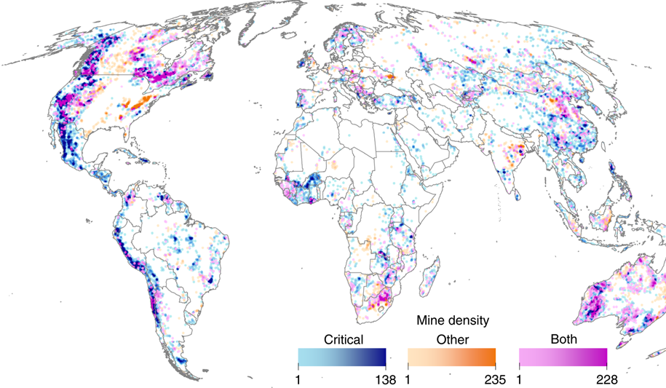
Space
Sonter, L.J., Dade, M.C., Watson, J.E.M. et al. Renewable energy production will exacerbate mining threats to biodiversity. Nat Commun 11, 4174 (2020). https://doi.org/10.1038/s41467-020-17928-5
Fig. 1: Global mining areas and their density. Mining areas were mapped using a 50-cell radius around 62,381 pre-operational, operational, and closed mining properties. Mining areas with properties targeting materials critical for renewable energy technology and infrastructure are shown in blue, areas with properties targeting other materials are shown in orange, and those targeting both commodity types are shown in pink. Color shading (light to dark) indicates the density of mining areas—i.e. the number of mining properties within a 50-cell radius of each 1 km cell

Slide 12
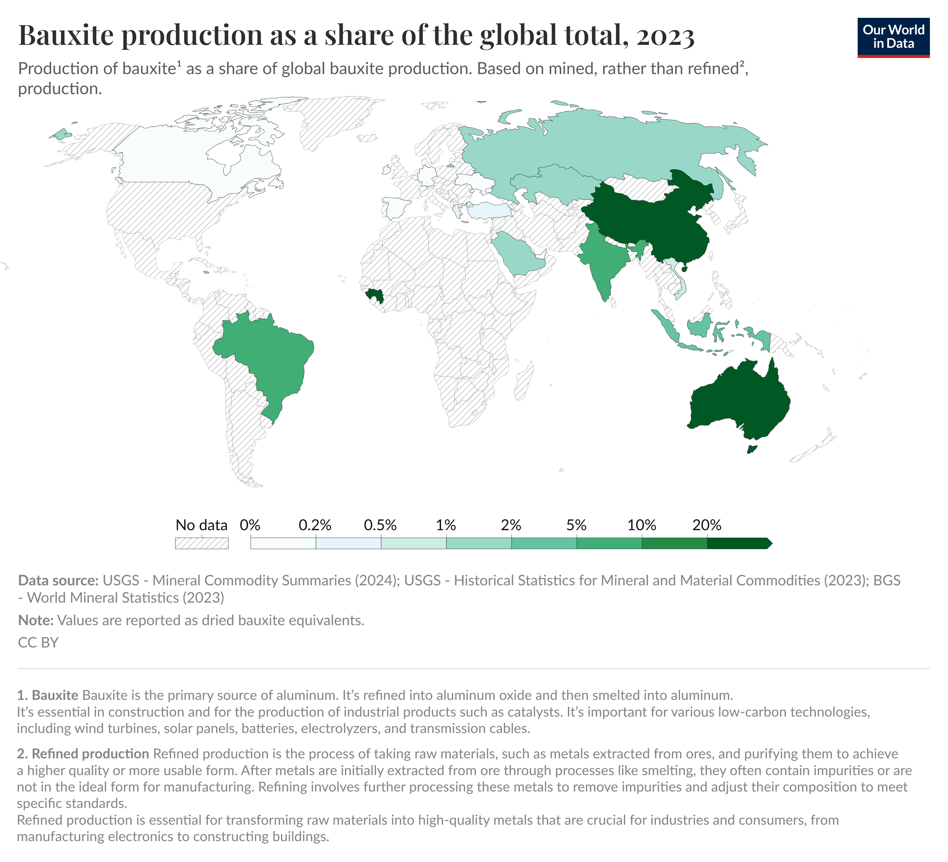
Space (and Time)
Which countries have the critical minerals needed for the energy transition? - Our World in Data

Slide 13
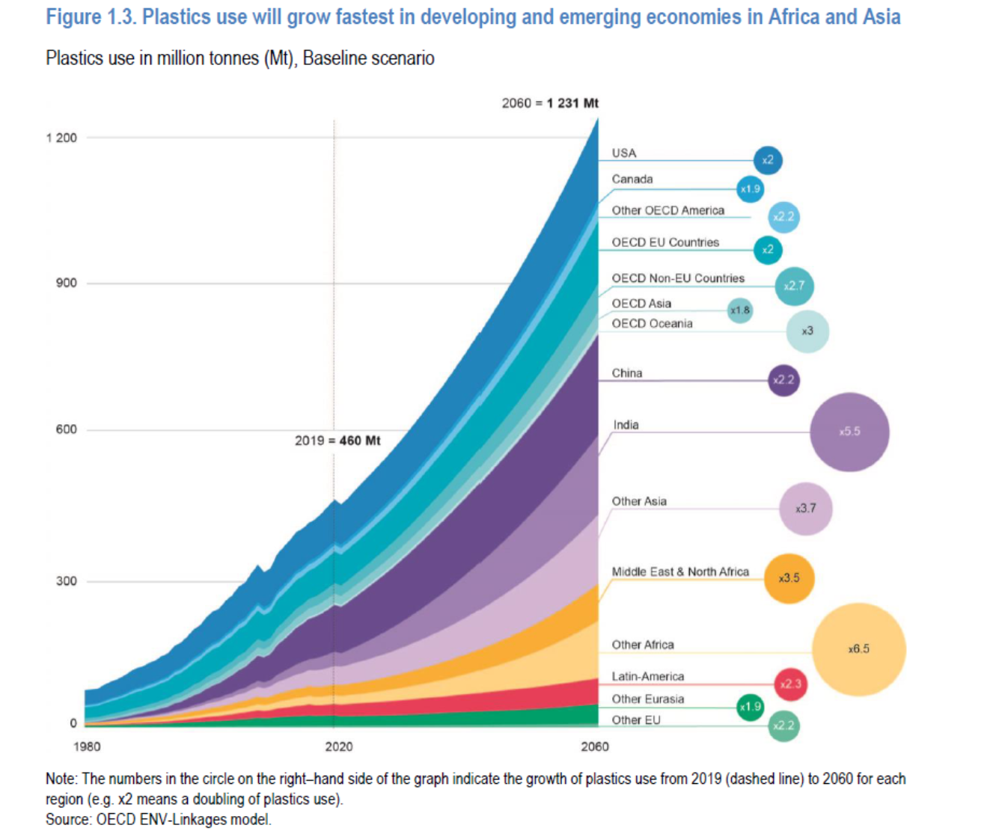
Time (and Space)
OECD Global Plastic Outlook (2022)
https://www.oecd.org/en/publications/global-plastics-outlook_aa1edf33-en.html

Slide 14
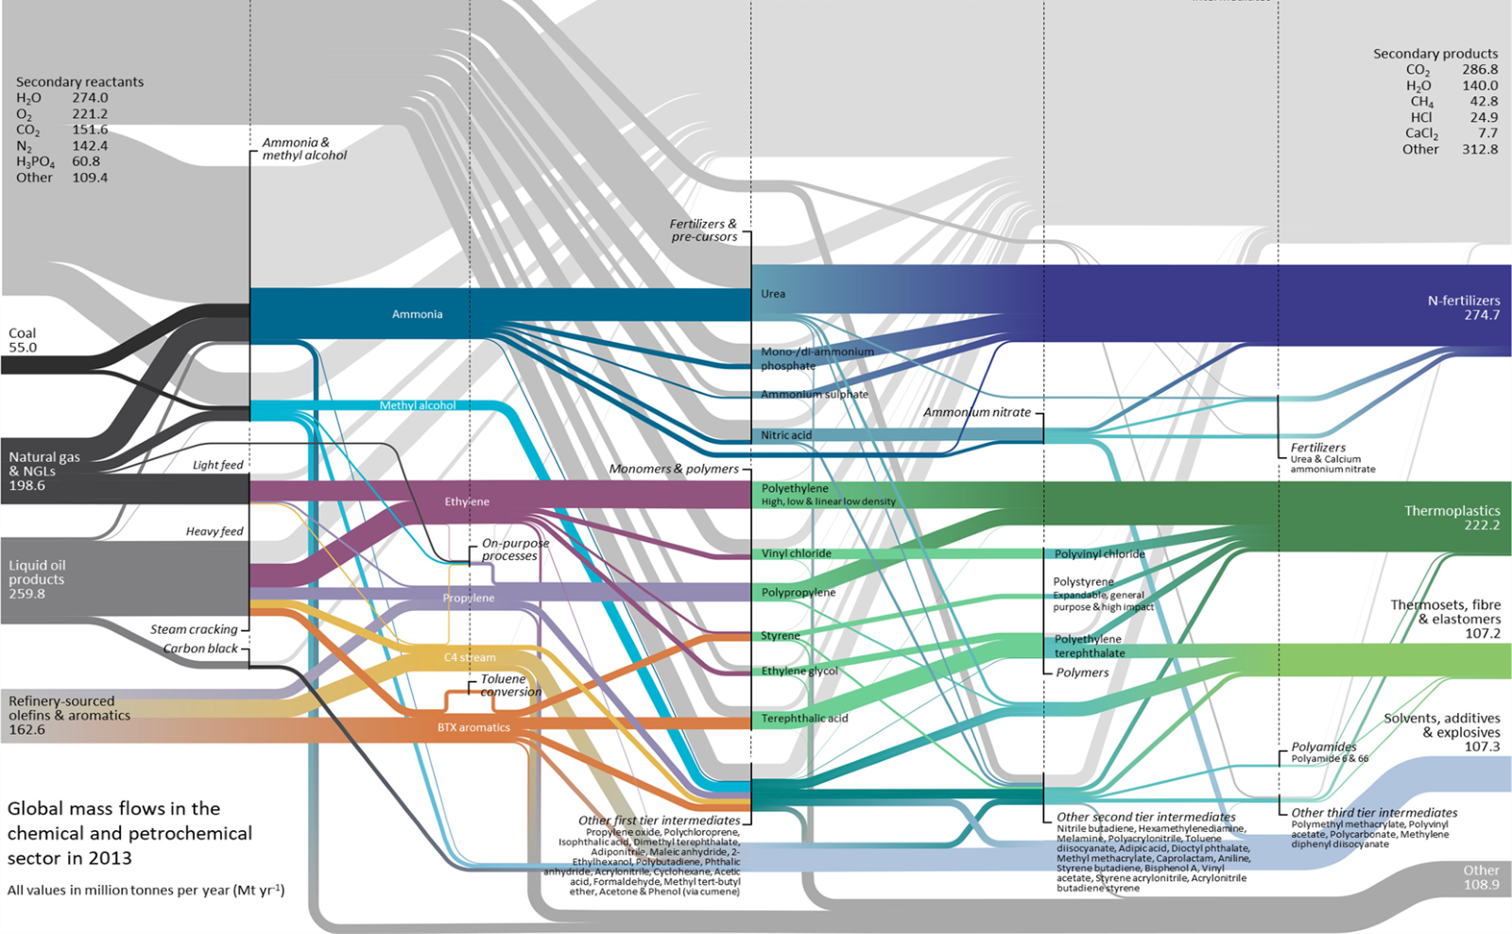
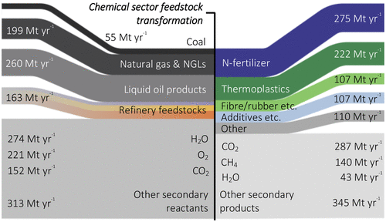
Flows
Mapping Global Flows of Chemicals: From Fossil Fuel Feedstocks to Chemical Products
Peter G. Levi and Jonathan M. Cullen Environmental Science & Technology 2018 52 (4), 1725-1734
DOI: 10.1021/acs.est.7b04573
Sankey diagram depicting the passage of feedstock through the chemical sector: from fossil fuel feedstocks to chemical products.

Slide 15
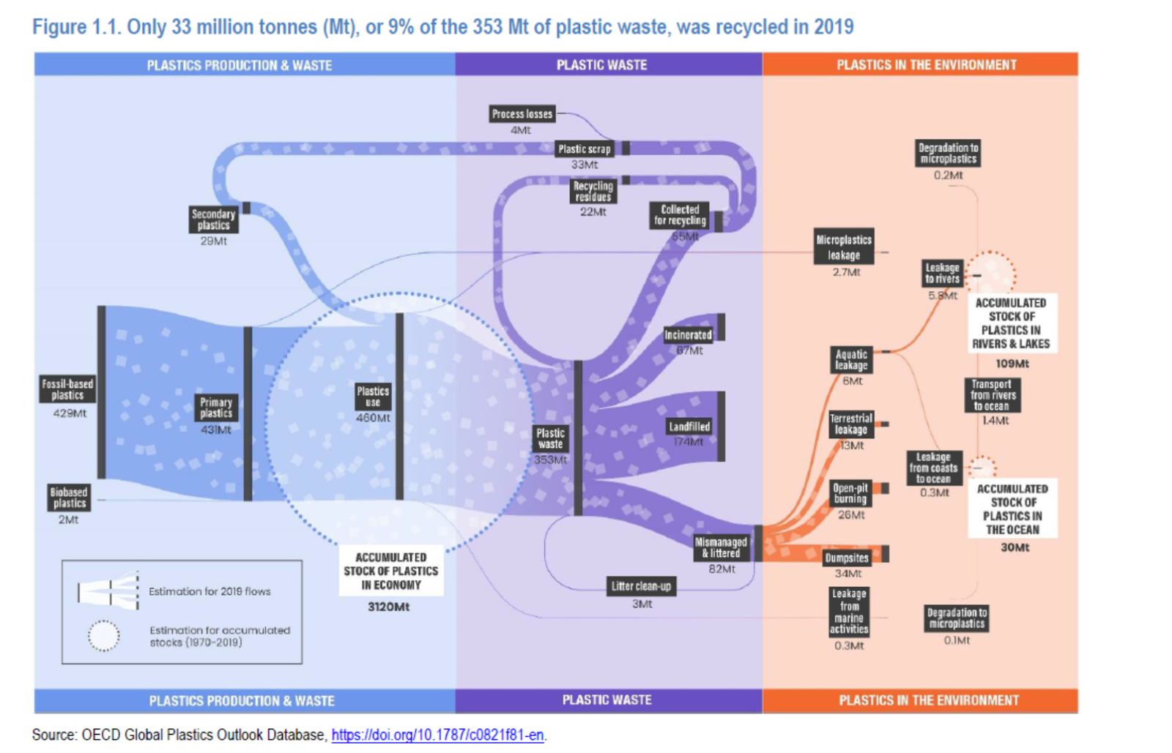
Flows

Slide 16
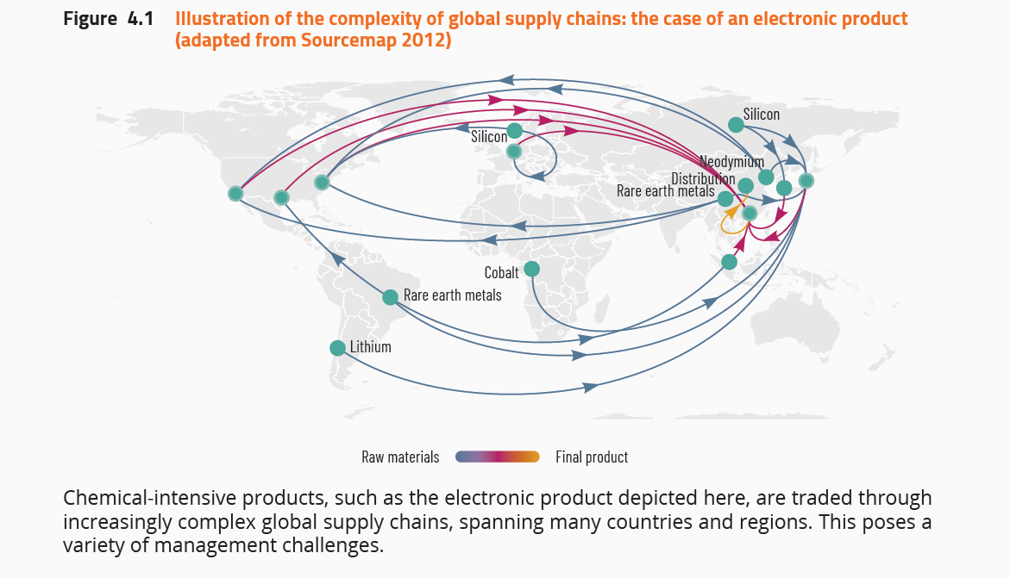
Flows and Space
UNEP’s Global Chemical Outlook II, 2019
https://www.unep.org/topics/chemicals-and-pollution-action/chemicals-management/global-chemicals-outlook

Slide 17
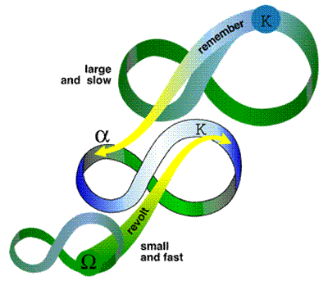
Flows, Time, Interscalar
Panarchy and the adaptive cycle
This Photo by Unknown Author is licensed under CC BY-NC

